Slide 1

AI Project
MAZE SOLVING
Body

Slide 2

Introduction
Exploring tricky mazes and labyrinths can be really hard. But now, thanks to smart computer programs such as AI-based Maze Solver, things are getting easier.
These programs use fancy math and learning tricks to find the best way through mazes.
In this report, we`ll learn about how these AI systems work and how they can help in lots of different areas. These smart Maze Solver programs are like super-smart puzzle solvers. They use special tricks to figure out the best, path, making maze exploration a breeze.

Slide 3
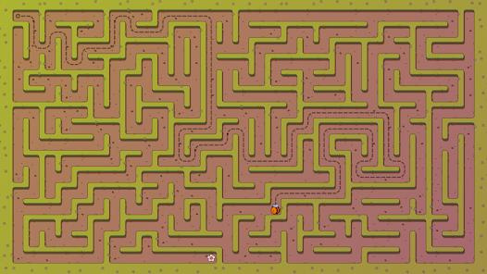
Problem Statement & Objective
The project aims to develop an AI-based solution for navigating through a complex maze, incorporating various challenges and obstacles.
The maze consists of multiple pathways, dead ends, traps, and distractions, making it crucial to devise an effective strategy to explore and navigate through the labyrinth efficiently.

Slide 4

Methodologies used
BFS-Breadth First Search
DFS- Depth First Search
UCS- Uniform Cost Search
A* Algorithm
Best First Search
Reinforcement Learning

Slide 5
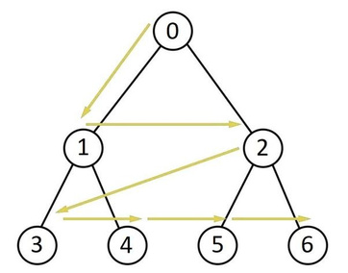
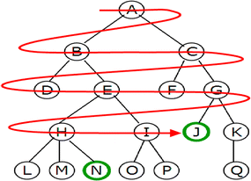
BFS-Breadth First Search
Breadth-First Search (BFS) is a simple search algorithm that explores a graph level by level. It starts from the root node and visits all the neighboring nodes first, before moving on to the next level.
BFS is like exploring a maze by checking each room adjacent to your current location before moving forward. It ensures that closer nodes are visited before deeper ones, making it effective for finding the shortest path in unweighted graphs.
In the code the bfs function implements the breadth first search algorithm.

Slide 6
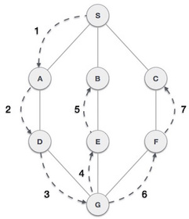
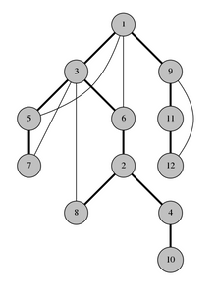
DFS-Depth First Search
Depth-First Search (DFS) is another search algorithm, but it explores as far as possible along each branch before backtracking. It starts from the root node and goes as deep as it can, then backtracks when it reaches a dead end.
DFS is like exploring a maze by taking one path until you can't go any further, then going back to try another. It's often used to search through large, complex graphs or mazes.
The dfs method implements the Depth First Search algorithm. It explores nodes by following a single path as far as possible before backtracking. This algorithm uses a stack to keep track of nodes to be explored.

Slide 7
UCS-Unifom Cost Search
Uniform Cost Search (UCS) is a graph traversal algorithm used in maze navigation. It systematically explores all possible paths from a starting point to a goal, prioritizing paths with lower cumulative costs.
UCS selects the path with the minimum cost encountered thus far, making it effective for finding the optimal solution in scenarios with varying edge traversal costs.
The ucs method implements the Uniform Cost Search algorithm to find the shortest path from the start to the end in the maze.
It maintains a priority queue (PriorityQueue) to explore nodes based on their cost. The cost of reaching each node is calculated as the sum of the costs of all the steps taken to reach that node.
The algorithm explores neighboring nodes in all four directions (up, down, left, right) and continues until the goal node is reached or all nodes are explored.

Slide 8
A* Algorithm
A* is a search algorithm like UCS, but it's more efficient. It looks at both the cost of getting to a point and an estimate of how much further it needs to go. This estimate helps it focus on the most promising paths.
A* is like planning a road trip, considering both the distance to your destination and how fast you can travel. It picks the path that seems shortest overall.
The a_star function implements this algorithm. This method works like UCS but it also takes a heuristic into account. A heuristic is a fuction that helps to make a guided decision.The heuristic in this case is the manhattan distance of the current node from the goal node.
The cost of reaching each node is calculated as the sum of the costs of all the steps taken to reach that node added to the heuristic of the node.
All the unvisited neighbours of the node are enqueued in a priority queue and the neighbour with the least cost is dequed. Due to this nature of the algorithm, we might see some jumps between nodes as the node may have a lesser total cost.

Slide 9
Best first search
Best-First Search (BFS) is an algorithm that explores paths based on an evaluation function. It selects the most promising node to expand next, based on a heuristic that estimates the cost to reach the goal from that node.
BFS is like navigating a maze by always choosing the path that seems closest to the destination. It's useful for efficiently finding solutions in large search spaces, prioritizing exploration towards potentially optimal paths.
In the code ,the best_first_search method implements the Best First Search algorithm. Similar to UCS, it explores neighboring nodes based on their heuristic value, which estimates the distance from the current node to the goal. In this implementation, the Manhattan distance heuristic is used, which is the sum of the absolute differences in the x and y coordinates between the current node and the goal.

Slide 10
Conclusion & Future Enhacements
Our project showcases UI visualizations for five maze traversal methods: UCS, A* Search, BFS, DFS, and RL. Each has strengths and weaknesses. UCS finds the most optimal solution but can be slow in complex mazes. A* balances optimality and speed with heuristics. BFS guarantees the shortest path but is memory-intensive. DFS is memory efficient but may overlook shorter paths. RL learns strategies but its performance varies with maze complexity and rewards. Understanding these trade-offs helps in choosing the best method for specific mazes and computational limits.
Future improvements could focus on developing parallel and distributed algorithms to make use of modern hardware like multi-core processors and GPUs. By doing tasks simultaneously, these algorithms can handle larger mazes faster, possibly enabling real-time maze-solving. Additionally, there's growing interest in using maze-solving algorithms in real-world fields like logistics and disaster response. Research could explore adapting these algorithms to solve practical problems such as optimizing routes or planning evacuations in complex environments.
We can also effectively solve the Wumpus world problem

Slide 11

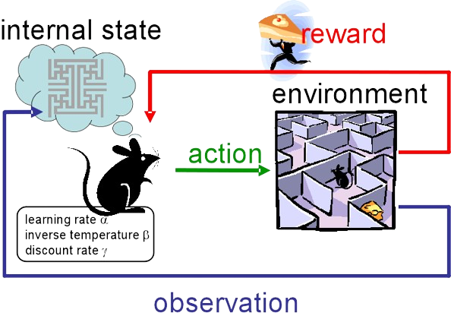
Reinforcement Learning

Slide 12
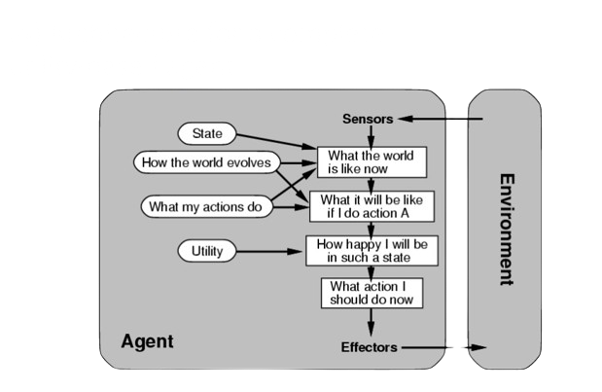
Inspiration
Our Reinforcement learning model very closely resembles a utility based agent.

Slide 13
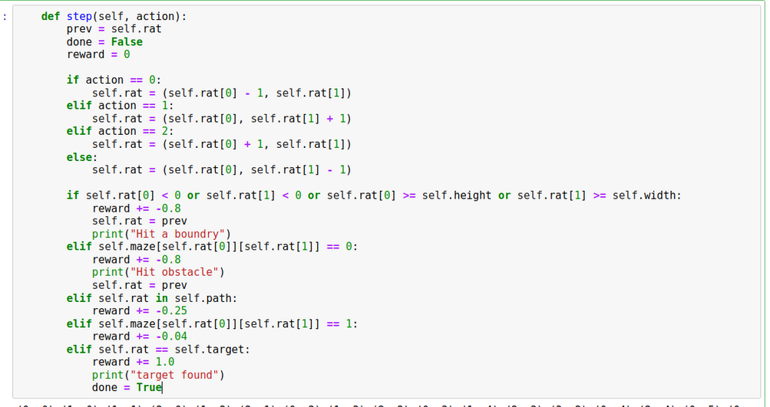
Environment:

Slide 14
Made By
Anish Setya
Akshay Saxena
Janav Bhasin
Yash Rohan

Slide 15

THANK YOU

